Slide 1
NPRB 2301 Sample Meeting
August 30 2023
GIThub repository for documents and data:
https://github.com/CindyTribuzio-NOAA/PSS_Ageing/tree/main

Slide 2
Agenda
Discuss sample sizes and flow
Sub sample criteria
Across lengths, sex, area?
Identify any more practice specimens
Identify first round of real samples

Slide 3
Sample Sizes
Species | Obj | Analysis | N Fish | N lense/fish | N layers/lens | Portions/layer (insol vs sol) | Total
PSS | Obj 2 - Dietary contributions | Bulk isotopes | 40 | 1 | 4 | 1 | 160
PSS | Obj 2 - Dietary contributions | CSIA-AA | 5 | 1 | 1 | 1 | 5
SD | Obj 2 - Maternal contributions | Bulk isotopes | 20 | 2 | 1 | 1 | 40
SD | Obj 2 - Maternal contributions | CSIA-AA | 5 | 1 | 1 | 1 | 5
PSS | Obj 2 - Measure turnover | AMS | 5 | 1 | 4 | 2 | 40
SD | Obj 2 - Measure turnover | AMS | 5 | 1 | 4 | 2 | 40
PSS | Obj 1 - Estimate age | AMS | 20 | 1 | 4 | 1 | 80
SD | Obj 1 - Estimate age | AMS | 20 | 1 | 4 | 1 | 80
PSS | Obj 1 - Estimate age, check eye consistency | AMS | 10 | 2 | 4 | 1 | 80

Slide 4
Sample Flow
All samples go to ARC first
Dan and students will separate layers and put into solution
AMS samples to LLNL
Bruce and tech will conduct centrifugation/drying and protein turnover and carbon analyses
Isotopes to Taylor
Taylor will conduct bulk and CSIA-AA

Slide 5
Subsampling Criteria
Sample Quality
“Great” - Scientific collections with well documented handling
“Good” - Generally observer collections with generally well documented handling
“Poor” - Samples that likely had delays between death and sampling or at least one thaw cycle
Data Quality
“Great” - Scientific collections with most accurate length and haul info
“Good” - Generally observer collections, presumed accurate lengths
“Medium” - LIkely accurate lengths, but not sure which length (PCL or TL), or spotty haul data
“Poor” - biological and/or haul data unable to be verified
“Waiting” - Generally observer collection in which I either do not yet have data form, or need to verify

Slide 6
Subsampling Criteria
Rank
“Best” - top priority samples, use all of them
“High” - sub-sample as needed
“Medium” - most of these will likely move to “High” as data get recovered and validated
“Low” - probably save for practice
“Lower” - last resort, practice only

Slide 7
Sample DATA!!!!
Non-confidential data are available on GIThub repository
NOTE: these data are not the final specimen data, as I continue error checking and adding observer haul data, this will change. For our purposes today, it is sufficient.

Slide 8
Sub-Sampling Criteria
By Region??
FMP Sub area | Best | High | Medium | Low | Lower | Grand Total
EBS |  | 37 |  |  |  | 37
AI | 1 | 5 |  |  |  | 6
CGOA |  | 1 |  |  |  | 1
WC |  |  | 47 |  |  | 47
SEI | 1 | 3 |  |  |  | 4
NA |  |  | 55 | 2 | 3 | 60
Grand Total | 2 | 46 | 102 | 2 | 3 | 155

Slide 9
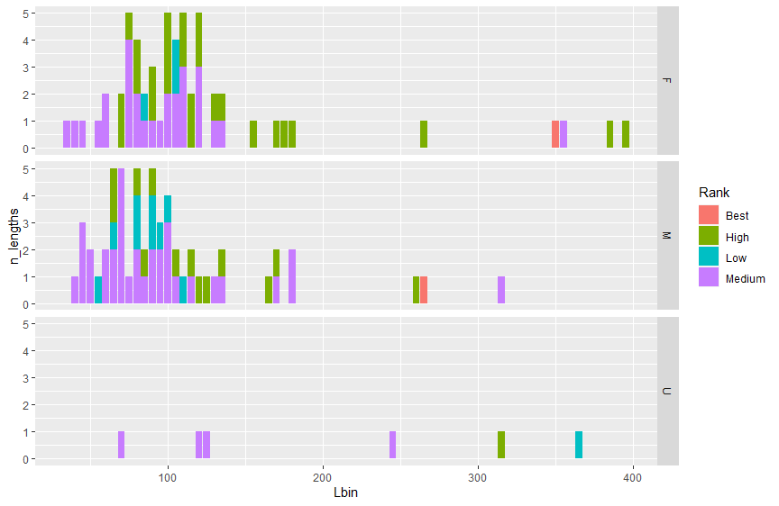
Sub-Sampling Criteria
By Size??
By Sex??

Slide 10
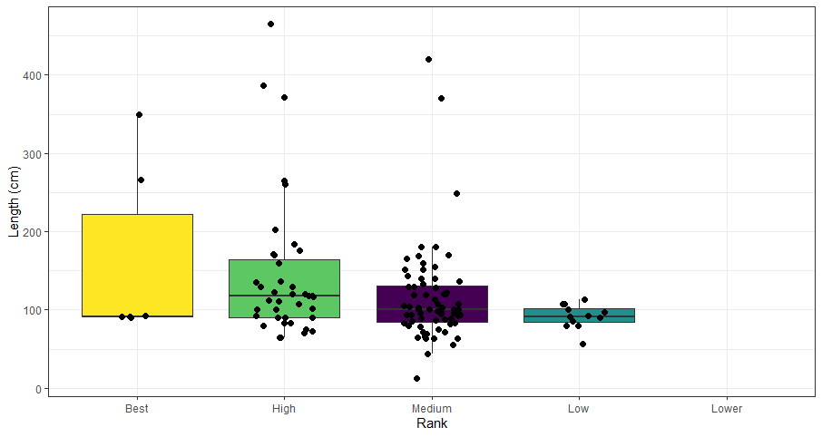
Sub-Sampling Criteria
By Size??
By Sex??

Slide 11
Notes
Dan’s timeframe for practice - shouldn’t take too much to scale up to larger lenses (unless the practice doesn’t work-then would need more meetings). Should take ~1 day to see if it will work. Dan will start by trying it himself. He’ll get back to us with some preliminary reports about a week after getting the samples
First PI meeting in person - January 2024
Check-in meeting early October
Cindy’s availability is limited now-mid December, but tech is working on finalizing database

Slide 12
Practice Samples
Do we need more practice specimens? - right now, only send expendable samples
Cindy will FedEx practice samples (~1 gallon bag) of PSS to Dan on 9/5/23
Will be a range of sizes to see if method works for larger eyes
Send some poor and higher quality to assess how quality affects processing
Will also send some dogfish (though the amount available is limited)-save for analysis for Bruce.
The older dogfish samples (pre-pandemic) might not be in great shape

Slide 13
First batch of real samples?
4 layers will span many years. Even from smaller dogfish, could get 6-7 layers. Do we want more layers from “Best/High” samples?
Every sample will be split into soluble/insoluble. Every layer increases the workload.
Instead of combining, better to isolate distinct layers.
Largest eyes might be really challenging to process.

Slide 14
Analytical Tasks/Manuscript Plan
-Cindy will work on a draft list for this and send to the group

